Slide 1
React Meetup Hamburg | October 2019 | @nilshartmann
NILS HARTMANN
https://nilshartmann.net
One Year
React Hooks
A (Critical) Review
Slides: https://nils.buzz/bedcon19-react

Slide 2
React Meetup Hamburg | October 2019 | @nilshartmann
NILS HARTMANN
https://nilshartmann.net
One Year
React Hooks
Consequences for your App
Slides: https://nils.buzz/bedcon19-react

Slide 3

https://nilshartmann.net
NILS HARTMANN
nils@nilshartmann.net
Developer, Architect, Trainer from Hamburg (Freelancer)
JavaScript, TypeScript
React
GraphQL
Java
Trainings, Workshops and Coachings

Slide 4
React Hooks
Anyone NOT knowing what Hooks are?

Slide 5
React Hooks
Anyone NOT knowing what Hooks are?
Hooks 2 Minute intro
add State, Lifecycle, Sideffects in functional components (almost no need for class components anylonger)

Slide 6
React Hooks
Anyone NOT knowing what Hooks are?
Hooks 2 Minute intro
add State, Lifecycle, Sideffects in functional components (almost no need for class components anylonger)
"Hooks into your components lifecycle"

Slide 7
React Hooks
Anyone NOT knowing what Hooks are?
Hooks 2 Minute intro
add State, Lifecycle, Sideffects in functional components (almost no need for class components anylonger)
"Hooks into your components lifecycle"
Regular JavaScript functions...
...but must start with 'use'
...but must not be used in conditionals, for/loops, Class components
...but behaviour is tied to React

Slide 8
React Hooks
Hooks example
import React, { useState } from "react";
export default function SettingsForm(props) {
const [favColor, setFavColor] = useState("blue");
return <•••>
<input value={favColor}
onChange={e => setFavColor(e.target.value) } />
<•••>
}
useState returns value and setter-function
When state changes, component re-renders
component function will run again

Slide 9
I have nothing against hooks, but...
React Hooks
Good or Evil?
Notes:
Bevor wir uns mit React beschäftigen, ein kurzer Hintergrund zum Thema Single-Page-Anwendungen.

Slide 10
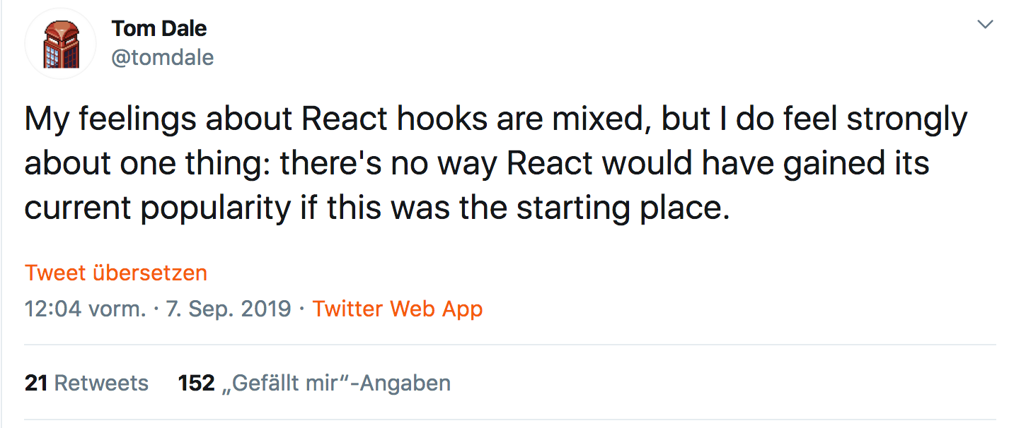
I have nothing against hooks, but...
https://twitter.com/tomdale/status/1170095532066430977
Notes:
Bevor wir uns mit React beschäftigen, ein kurzer Hintergrund zum Thema Single-Page-Anwendungen.

Slide 11
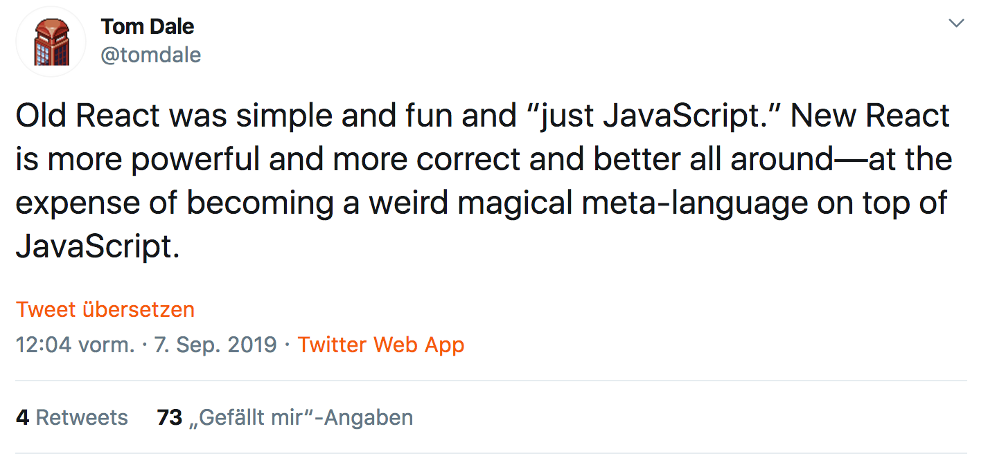
I have nothing against hooks, but
https://twitter.com/tomdale/status/1170095532922064901
Notes:
Bevor wir uns mit React beschäftigen, ein kurzer Hintergrund zum Thema Single-Page-Anwendungen.

Slide 12
React Hooks
A LOOK AT THE API
Notes:
Bevor wir uns mit React beschäftigen, ein kurzer Hintergrund zum Thema Single-Page-Anwendungen.

Slide 13
A look at the api
useContext to access React Context in your functional component
export default function SettingsForm(props) {
const contextValue = React.useContext(ThemeContext);
return <p>Your context color: {contextValue.color}</p>
}

Slide 14
A look at the api
useContext to access React Context in your functional component
export default function SettingsForm(props) {
const contextValue = React.useContext(ThemeContext);
return <p>Your context color: {contextValue.color}</p>
}
Noteable: This is probably easy to understand: I want to use context "ThemeContext" here in my component

Slide 15
A look at the api
useContext to access React Context in your functional component
export default function SettingsForm(props) {
const contextValue = React.useContext(ThemeContext);
return <p>Your context color: {contextValue.color}</p>
}
Noteable: This is probably easy to understand: I want to use context "ThemeContext" here in my component
But: if context changes, my component re-renders ?! Why? Because it's a ... Hook ("weird magical meta-language") There is no indicator that this will happen. Syntactically "only" JavaScript

Slide 16
A look at the api
useState for local State in your functional component
export default function SettingsForm(props) {
const [ favColor, setFavColor ] = useState("red");
return <input value={favColor}
onChange={e => setFavColor(e.target.value) />
}

Slide 17
A look at the api
useState for local State in your functional component
export default function SettingsForm(props) {
const [ favColor, setFavColor ] = useState("red");
return <input value={favColor}
onChange={e => setFavColor(e.target.value) />
}
Noteable: Return Value
what is this? Tuple! (btw: I think Tuples will make it to JavaScript)
unsual (yet), but elegant, allows to name my variables as I want them to

Slide 18
A look at the api
useState for local State in your functional component
export default function SettingsForm(props) {
const [ favColor, setFavColor ] = useState("red");
return <input value={favColor}
onChange={e => setFavColor(e.target.value) />
}
Noteable: Return Value
what is this? Tuple! (btw: I think Tuples will make it to JavaScript)
unsual (yet), but elegant, allows to name my variables as I want them to
Noteable: initial value, used only once even if this method is run on each render Why? Because it's a ... Hook ("weird magical meta-language")

Slide 19
A look at the api
useState for local State in your functional component
export default function SettingsForm(props) {
const [ favColor, setFavColor ] = useState("red");
return <input value={favColor}
onChange={e => setFavColor(e.target.value) />
}
Noteable: Return Value
what is this? Tuple! (btw: I think Tuples will make it to JavaScript)
unsual (yet), but elegant, allows to name my variables as I want them to
Noteable: initial value, used only once even if this method is run on each render Why? Because it's a ... Hook ("weird magical meta-language")
Noteable: setter-Function leads to re-render Why? Because it's a ... Hook ("weird magical meta-language")

Slide 20
A look at the api
useEffect for sideeffects
export default function SettingsForm(props) {
useEffect( () => { start(); return () => stop() }, [])
return <...>
}
Noteable: Everything
what is a sideeffect? API call, DOM API, console.log?
what is 2nd argument ("dependency array")
unsual way to "limit" call to functions
btw: what does [] semantically mean? Let's call the experts!

Slide 21
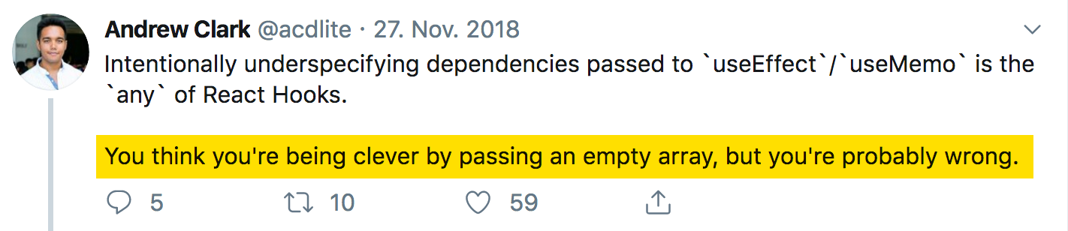
A look at the api
useEffect for sideeffects
https://twitter.com/acdlite/status/1067541310377123840

Slide 22
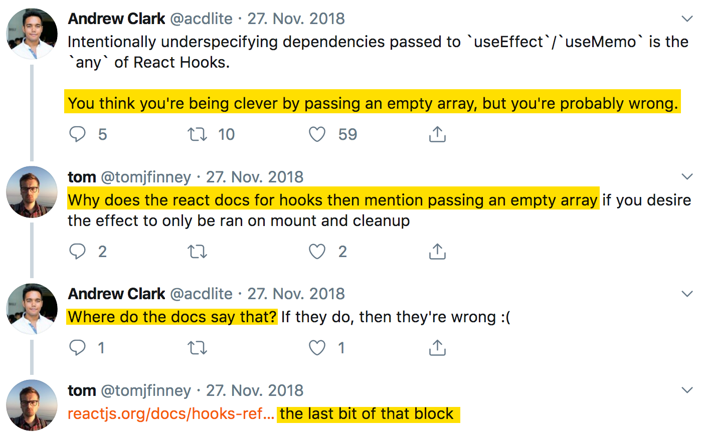
A look at the api
useEffect for sideeffects

Slide 23
A look at the api
useEffect for sideeffects

Slide 24
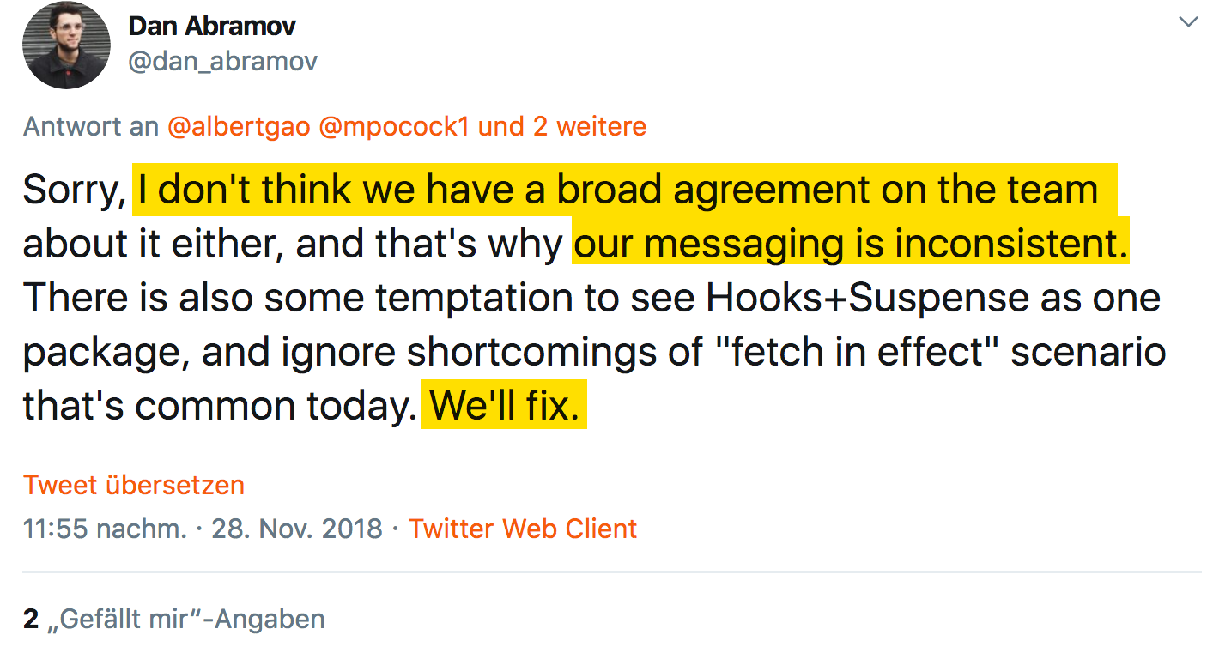
A look at the api
useEffect for sideeffects
https://twitter.com/dan_abramov/status/1067914987753091074

Slide 25
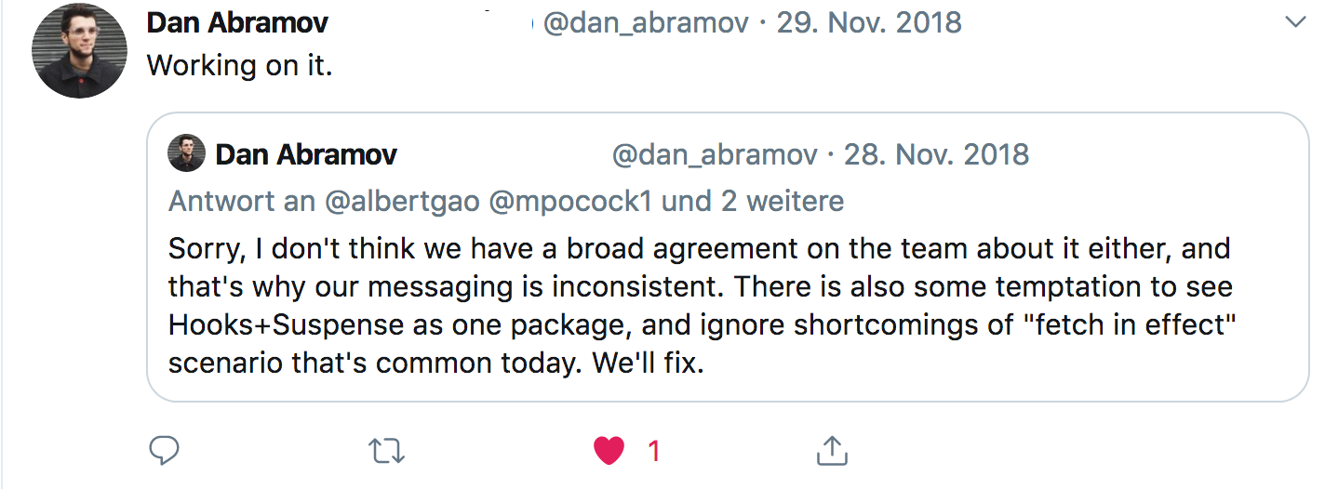
A look at the api
useEffect for sideeffects
https://twitter.com/dan_abramov/status/1067917403709943808?s=20

Slide 26
A look at the api
useEffect for sideeffects
https://twitter.com/dan_abramov/status/1067917403709943808?s=20
- end of thread -

Slide 27
React Hooks
USING HOOKS
Notes:
Bevor wir uns mit React beschäftigen, ein kurzer Hintergrund zum Thema Single-Page-Anwendungen.

Slide 28
Using hooks
Using Hooks: this is simple...
import React, { useState } from "react";
export default function SettingsForm(props) {
const [ favColor, setFavColor ] = useState("blue");
return <input value={favColor} onChange={...} />
}

Slide 29
using hooks
Using Hooks: let's add context...
import React, { useState, useContext } from "react";
export default function SettingsForm(props) {
const login = useContext(LoginContext);
const [ favColor, setFavColor ] = useState("blue");
return <input value={favColor} onChange={...} />
}

Slide 30
using hooks
Using Hooks: and now... boom!
import React, { useState, useContext } from "react";
export default function SettingsForm(props) {
const login = useContext(LoginContext);
if (login.loggedIn) {
return <Redirect to="/login" />
}
const [ themeColor, setThemeColor ] = useState("blue");
return <input value={themeColor} onChange={...} />
}

Slide 31
using hooks
Using Hooks: and now... boom!
import React, { useState, useContext } from "react";
export default function SettingsForm(props) {
const login = useContext(LoginContext);
if (login.loggedIn) {
return <Redirect to="/login" />
}
const [ themeColor, setThemeColor ] = useState("blue");
return <input value={themeColor} onChange={...} />
}
Why? Because it's a ... Hook ("weird magical meta-language")

Slide 32
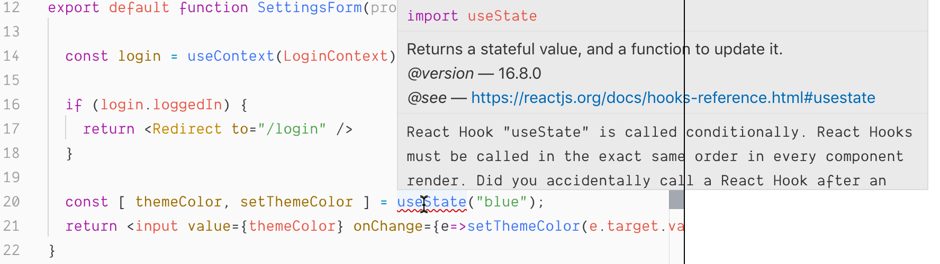
using hooks
Linter: saves us!

Slide 33
using hooks
...and another one: useHistory from React Router
import { useHistory } from "react-router-dom";
export default function SettingsForm(props) {
function saveAndRedirect() {
saveSettings().then(
() => useHistory().push("/home")
);
}
return <•••><button onClick={saveAndRedirect}>Save</button><•••>
}

Slide 34
using hooks
...this works
import { useHistory } from "react-router-dom";
export default function SettingsForm(props) {
const history = useHistory();
function saveAndRedirect() {
saveSettings().then(
() => history.push("/home")
);
}
return <•••><button onClick={saveAndRedirect}>Save</button><•••>
}
Might not be big difference, but...

Slide 35
using hooks
Might not be a big difference, but...
we may have lots of unneccessary useHistory calls (or other Hooks)
you have to know where you can use Hooks
forces you to structure my code in exactly this way
it's not "standard javascript"
Do you remember why React doesn't add a template language?
To allow us the use of our "favorite" language: JavaScript
no need to learn a new language...
Does that mean Hooks or React is evil?
No, but...

Slide 36
using hooks
useEffect in Action!
import { useState, useEffect } from "react";
export default function SettingsForm(props) {
const [ settings, setSettings ] = useState(null);
useEffect(
() => loadSettings().then( s => setSettings(s) )
);
return <•••> </•••>
}
Boom! Climate change happening right now
To be fair: Linter warns you. But who listens to Linters?

Slide 37
of using Hooks
Consequences
Notes:
Bevor wir uns mit React beschäftigen, ein kurzer Hintergrund zum Thema Single-Page-Anwendungen.

Slide 38
Consequences
HOC might be replaced by Custom Hook
That's good imho
HOCs hard to understand
Multiple HOCs might collidate if using same Properties
But... (oh no, not again!)

Slide 39
A look at the api
Example: Router useLocation and useProps instead of connect
import { useDispatch, useSelector } from "react-redux";
export default function SettingsForm(props) {
const favColor = useSelector(state => state.theme.favColor);
const dispatch = useDispatch();
const setNewColor = (r,g,b) => dispatch(actions.setNewColor(r,g,b));
return <•••><ColorPicker onSet={setNewColor}/><•••>
}

Slide 40
A look at the api
Example: Redux useDispatch and useSelector instead of connect
import { useDispatch, useSelector } from "react-redux";
export default function SettingsForm(props) {
const favColor = useSelector(state => state.theme.favColor);
const dispatch = useDispatch();
const setNewColor = (r,g,b) => dispatch(actions.setNewColor(r,g,b));
return <•••><ColorPicker onSet={setNewColor}/><•••>
}

Slide 41
A look at the api
Example: Redux useDispatch and useSelector instead of connect
import { useDispatch, useSelector } from "react-redux";
export default function SettingsForm(props) {
const favColor = useSelector(state => state.theme.favColor);
const dispatch = useDispatch();
const setNewColor = (r,g,b) => dispatch(actions.setNewColor(r,g,b));
return <•••><ColorPicker onSet={setNewColor}/><•••>
}
Consequences:
We now have one component (no HOC anymore)
the component is bound to Redux
todo:
dieses beispiel (component bound to redux) an hand von router zeigen
zeigen, dass es vor- und nachteile hat (colocation dafür enge kopllung uu schwerer zu testen)
redux nur für re-renderiungs

Slide 42
A look at the api
Example: Redux useDispatch and useSelector instead of connect
import { useDispatch, useSelector } from "react-redux";
export default function SettingsForm(props) {
const favColor = useSelector(state => state.theme.favColor);
const dispatch = useDispatch();
const setNewColor = (r,g,b) => dispatch(actions.setNewColor(r,g,b));
return <•••><ColorPicker onSet={setNewColor}/><•••>
}
Consequences:
We now have one component (no HOC anymore)
the component is bound to Redux
It has different rendering behaviour (not related to redux)
"forces" re-rendering of the ColorPicker component

Slide 43
A look at the api
We can this:
import { useDispatch, useSelector } from "react-redux";
export default function SettingsForm(props) {
const favColor = useSelector(state => state.theme.favColor);
const dispatch = useDispatch();
const setNewColor = React.useCallback(
(r,g,b) => dispatch(actions.setNewColor(r,g,b)),
[ dispatch ]
);
return <•••><ColorPicker onSet={setNewColor}/><•••>
}
"Nice!" (Fortunately we only have one callback function here...)
Remember the dependency array?

Slide 44
A look at the api
Again: is this really a problem?
In most cases not as performance might be good enough to re-render all the time
I wonder how many CPU engery is wasted due to billions of unneccessary re-renderings in React Apps world wide 🤓
But this is – esp. for Beginners – not easy to understand (call me a Beginner)

Slide 45
with Hooks
TypeScript
Notes:
Bevor wir uns mit React beschäftigen, ein kurzer Hintergrund zum Thema Single-Page-Anwendungen.

Slide 46
TypeScript
Type Inference with useState works very good!
function useAppSelector<R>(fn: (state: AppState) => R): R {
return useSelector(fn)
}
export default function SettingsForm(props) {
const favColor = useAppSelector(state => state.favColor);
return •••;
}

Slide 47
TypeScript
...custom hook for typing useSelector?
function useAppSelector<R>(fn: (state: AppState) => R): R {
return useSelector(fn)
}
export default function SettingsForm(props) {
const favColor = useAppSelector(state => state.favColor);
return •••;
}

Slide 48
Summary
Summary
Hooks are kind of a new (meta-)language
they solve problems
but they raise new ones
Through new ways we even have more ways to structure our code
React was always about flexibility... some like, some don't
I don't like hypes and that's probably the real reason I'm sceptical

Slide 49
nils@nilshartmann.net
NILS HARTMANN
https://nilshartmann.net
🌻
Thanks a lot!
(and don't hesitate to discuss hooks with me)
Slides: https://nils.buzz/bedcon19-react

